Slide 1




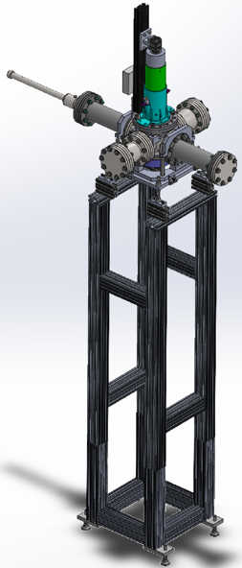
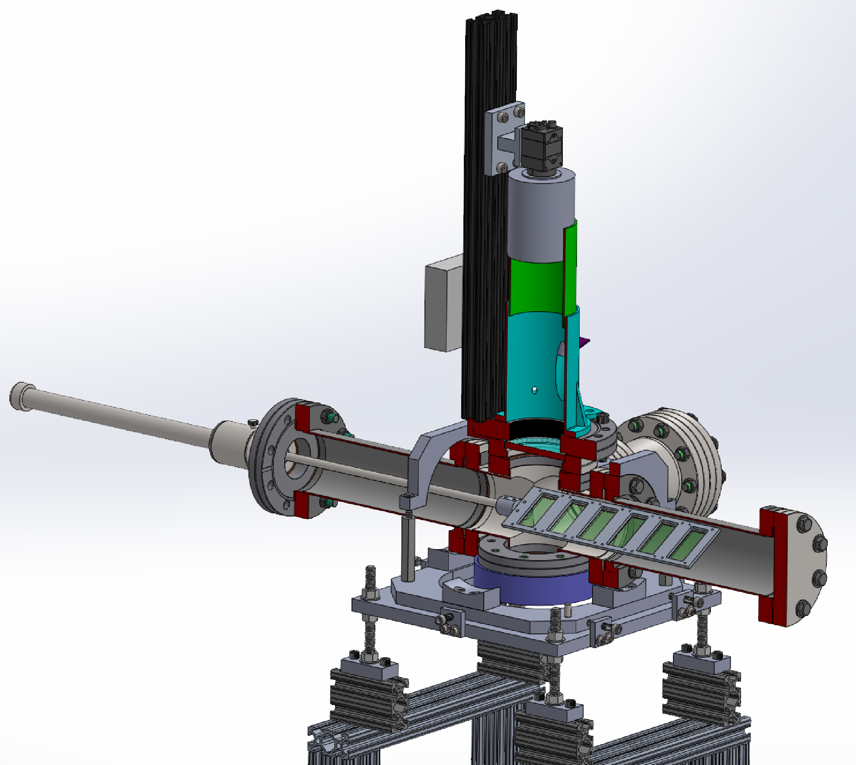
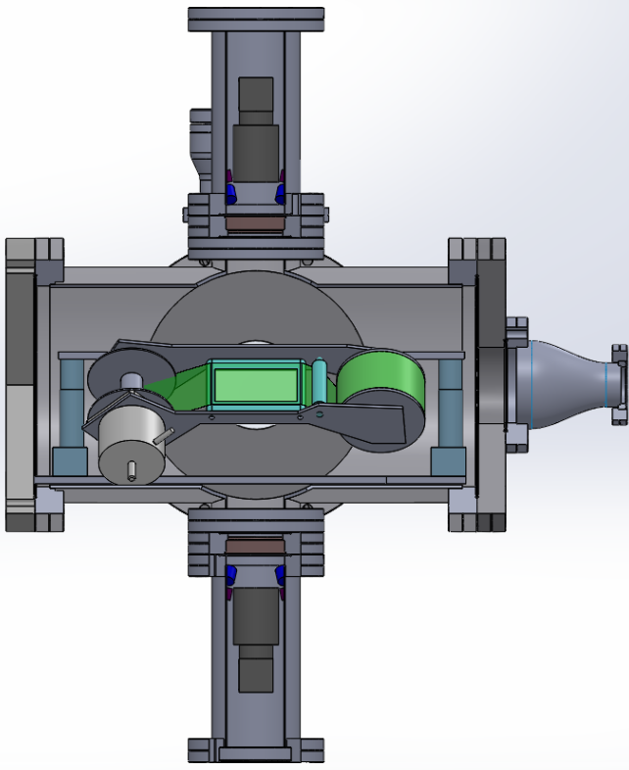
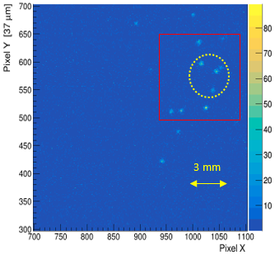
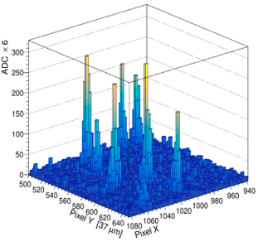
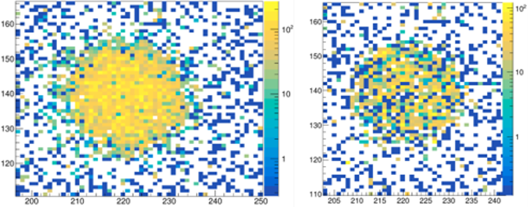
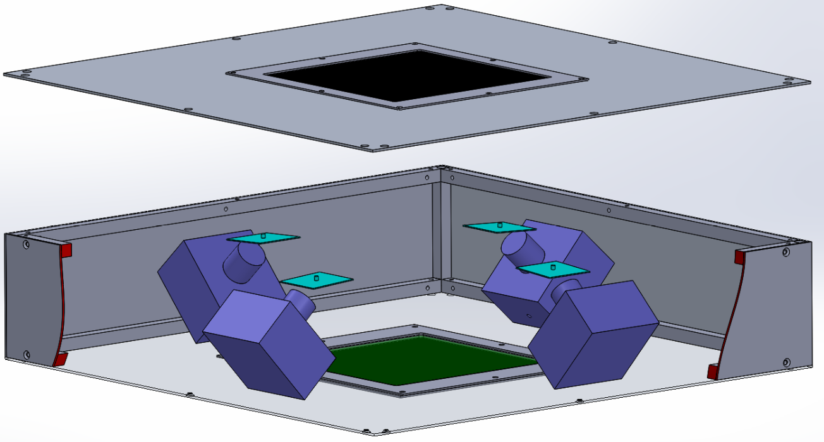
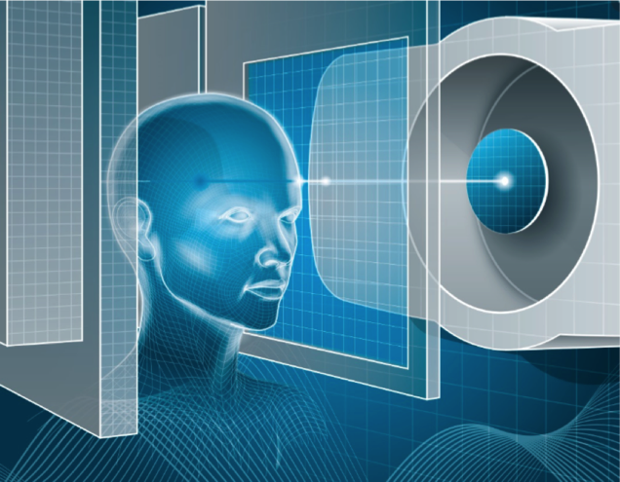
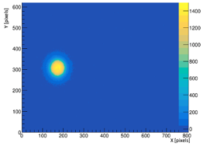
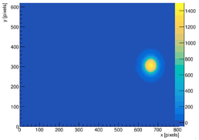
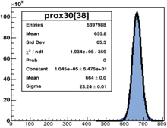
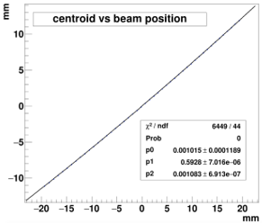
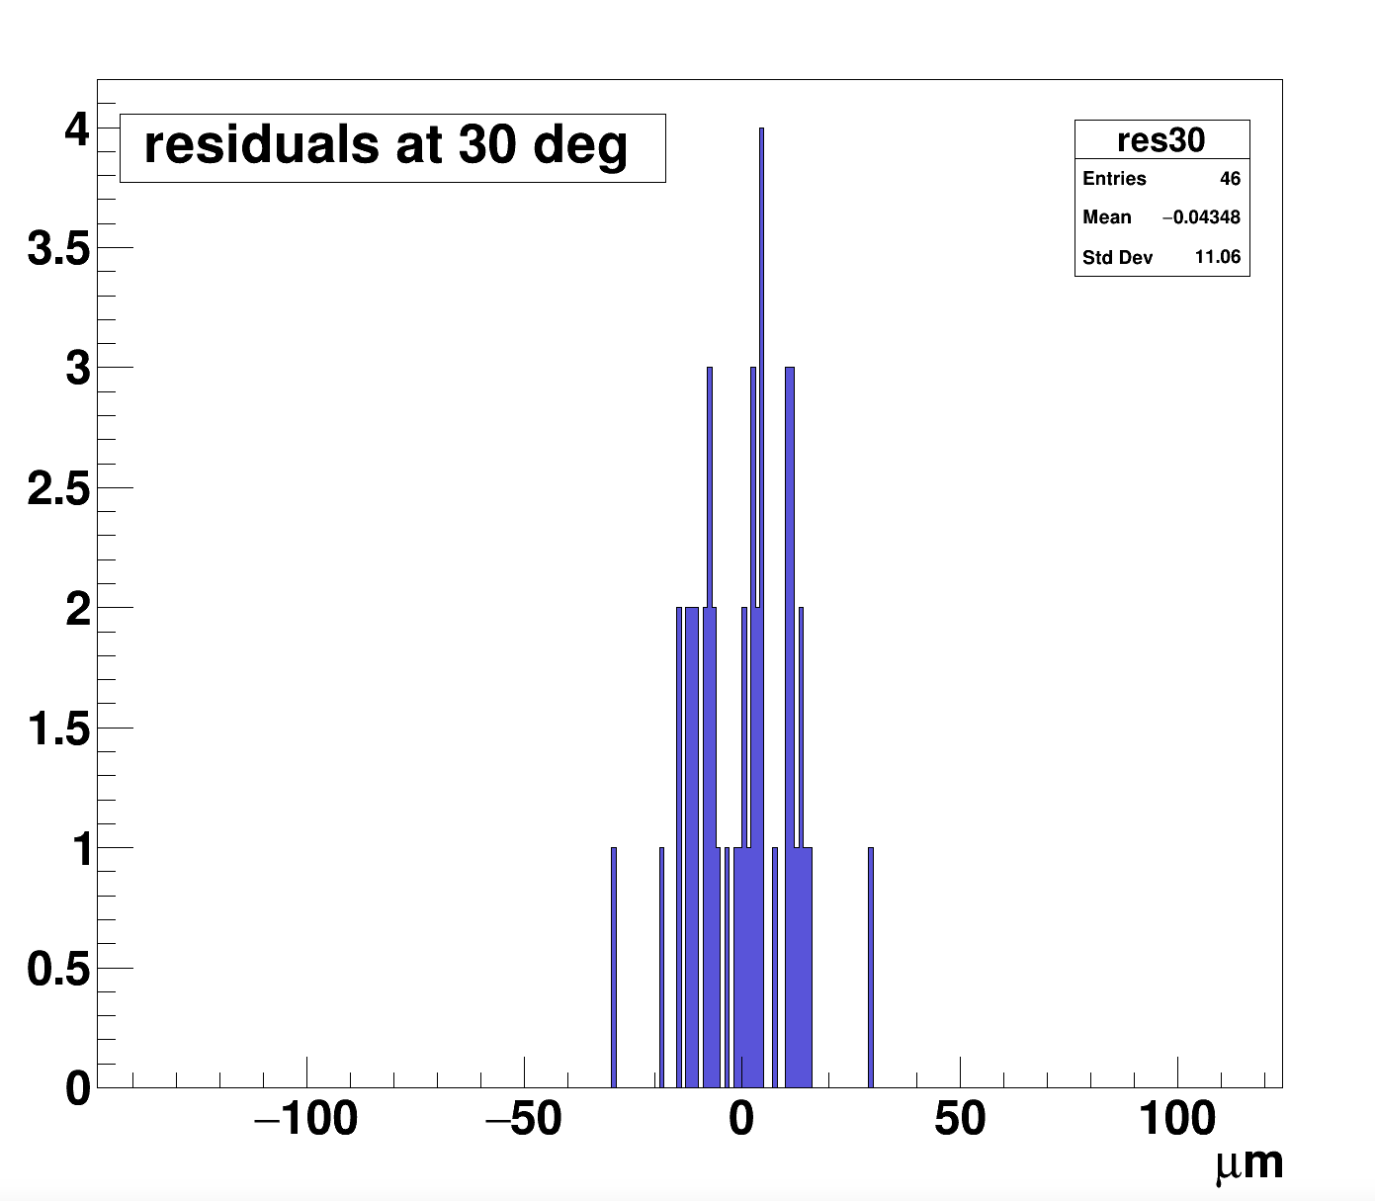
Novel Thin-Scintillator Beam Imager
P. S. Friedman --- Integrated Sensors, LLC, Ottawa Hills, Ohio
D. S. Levin, N. Ristow, C. Ferretti --- University of Michigan, Department of Physics, Ann Arbor, MI
T. N. Ginter, M. Cortesi --- Michigan State University, Facility for Rare Isotope Beams (FRIB), E. Lansing, MI
V. Bashkirov, R. Schulte --- Loma Linda University, School of Medicine, Loma Linda, CA
PSD12: Birmingham UK, Sept 16, 2021
Particle beam imaging monitor uses 2 novel scintillators + machine vision CMOS camera + large aperture lens
Scintillators:
Type 1 - PM ➔ An ultra-thin, semi-crystalline Polymer Material:
    demonstrated for nuclear physics & medical imaging
    hazy material, no total internal reflection (T.I.R), photons escape from surface
    reduced back surface reflection
    radiation damage resistance, superior to plastic scintillators such as BC-400
    available thickness from ~ 2 µm to 250 µm
    higher light-yield than PVT (polyvinyltoluene) and PS (polystyrene) based plastic scintillators
Type 2 - HM ➔ Hybrid Multilayer scintillator:
    demonstrated for nuclear physics & medical imaging
    reduced back surface reflection, no T.I.R.
    variety of time constants
    thickness from 200-400 µm
    high light yield > 5 times light yield of BC-400
    Lambertian radiator --> angular independence of emitted light intensity
Cameras:
Standard option: low cost CMOS machine vision camera from many tested:
    relatively large pixel size
    improved pixel Q.E.
    improved pixel-to-pixel noise uniformity
    improved photon angular acceptance at smallest f-number
    result ➔ twice the ADC signal with better noise characteristics
Alternative option: sCMOS camera with low noise (0.7 e) + high sensitivity 16 bits, but at much higher cost
Lens: Ultrafast f/0.9 aperture
Capability: Single-particle imaging for protons & ions: alphas in lab, heavy-ions at FRIB
Real-time beamline tuning/monitoring for nuclear physics: analysis and display updated at 1 Hz
    includes corrections for: noisy pixels, depth-of-field distortion, background subtraction, perspective view transformations
    internal calibrations with UV-LEDs and UV-photodiode readout
    scintillators can quickly be shifted in/out of beam without breaking vacuum
    six scintillators includes HM type and several thickness of PM type, plus a reference CsI(Ti)
    display of beam centroids, widths vs. time, current 2D centroid, intensity, ADC spectrum, etc.
beam
Camera
F/0.9 lens
Lens hood
Instrument staged at FRIB
Scintillator “ladder”
Alternate beamline monitor with scintillator film roll
Single Particle Sensitivity
PM vs. BC-400 Scintillator
190 µm thick PM scintillator vs. 200 µm thick BC-400
Single particle capture: Above images reveal isolated alpha particle hits from a weak ²⁴¹Am source irradiating a 2x2 cm wafer of HM type scintillator and recorded with a sCMOS camera at 10 ms exposure. Lego plot on right of hits within red box on left is re-binned for clarity and shows strong signals.
Test conditions:
⁹⁰Sr beta source (2 MHz/cm²)
3 mm diameter collimated beam
energy loss = 0.05 MeV
camera: 3 MP, 1.3 e RMS noise, gain 24 db
1 sec exposure and f/0.9 lens
Signals:
~ 250 ADC counts in PM vs < 100 ADC counts in BC-400
much higher hit density recorded in PM scintillator
FLASH Radiation Therapy (RT) Application as an Ultra-Fast Beam Monitor
Spatial Resolution
Beam position End
Exploded view of the detector with folded optics (left) to be positioned between beam snout and patient (right).
Beam position Start
FLASH effect: Radiation-induced healthy tissue toxicities can be reduced without affecting tumor control by ultra-fast delivery of radiation at dose rates orders-of-magnitude greater than conventionally fractionated external beam RT clinical practice (EBRT).
FLASH RT implies that higher radiation dose treatments are possible, thereby, it increases the therapeutic index over conventional EBRT.
FLASH delivers >40 Gy/s dose in ~ 0.1 s for 1-4 treatments. For protons: beam rates are ~ 10¹²⁻¹³ particles / sec (pps). Conventional EBRT delivers 10⁹⁻¹⁰ pps, or 1-2 Gy/minute, 5-times per week, over several weeks of treatment and sometimes up to 1-2 months.
The ultra-fast FLASH beam monitor adopts the design shown above using an array of fast imaging cameras operating at readout/analysis speeds of ~ 10 KHz.
Standard dosimetry currently used for monitoring first clinical FLASH treatments (e.g., with the advanced Markus Chamber) does not fulfill the needs for FLASH dose rates & large-area coverage.
This fast readout and low mass (< 0.5 mm water equivalent thickness) technology will enable clinical trials of FLASH.
Monitor is positioned between beam nozzle exit point and patient, provides immediate (100 µs), spatially resolved dosimetric analysis and machine feedback signals for fast termination.
Compact unit covers 26 cm x 30 cm with folded optics and multiple cameras.
Spatial resolution expected to be 100 µm or better.
Internal calibration system with UV-sources and UV-photodiode monitoring,
Linear-Quadratic fit corrects for depth-of-Field defocusing
Resolution: RMS width of residuals = 11 𝜇m
Method:
Scan beam from laser (or beta source) across field-of-view with precision stepper
Reconstruct centroids
Obtain fit of centroid means vs. true beam position
Non-linear fit corrects for depth-of-field defocusing
Residual distribution from fit gives the resolution
This work is funded by the U.S. Dept. of Energy under FOA opportunity number: DE-FOA-0002155

